Slide 1
Introduction to Computer Science (371-1-1601)
Lectures by: Dr. Dan Vilenchik & Dr. Zion Siksik
Recitations by: Ariel Cohen, Moshiko Davidian, Assaf Livne, Yair Mazal

Slide 2
Recitation 7 Iterators & Generators

Slide 3
Todays topics
Lambda functions
Iterators
Generators

Slide 4
Lambda function
# can be used for inline functions: x = lambda num: num * 2 print(x(10))
# Lambda functions can have several arguments: x = lambda x, y, z: x*y + z print(x(10, 2, 3))
What is the type of ‘x’?
What is the scope of the Lambda function?
Still work but not recommended
Notes:
<class 'function'>
Scope of a Lambda Expression. The body of a lambda expression has the same scope as a nested block.
The same rules for name conflicts and shadowing apply.

Slide 5
Lambda function
# can be used for inline functions: x = lambda num: num * 2 print(x(10))
# Lambda functions can have several arguments: x = lambda x, y, z: x*y + z print(x(10, 2, 3))
The above expressions are a bit problematic as they allow redefinition of the function.
Better uses shown in next slides
What about functions?
What is the type of them?
What is the type of ‘x’?
What is the scope of the Lambda function?
Notes:
Type of function - <class 'function'> \ <function func1 at 0x000002B19C47C3A0>
Type of Lambda function - <class 'function'>

Slide 6
Pythonic switch case
arg = 'dummy' task1 = 'vowels' task2 = 'typo’
tasks_dict = {'vowels': lambda x: get_number_of_vowels(x),
'perfect': lambda x: get_perfect_number(x), 'lazy': lambda x: get_lazy_caterer_number(x)}
print(tasks_dict.get(task1, lambda x: 'wrong input')(arg)) print(tasks_dict.get(task2, lambda x: 'wrong input')(arg))
Lambda expressions are used to send ‘arg’ to the function
‘get’ default argument handels wrong input
Notes:
task2 = 'typo’
The 'typo' key is not defined in the dictionary and therefore the default value will be returned which is actually the lambda function that returns the 'wrong input' statement for each input

Slide 7
Iterators
Iterators allow us to iterate
They are behind the scenes in every loop you use.
Can be used directly with the ‘iter’ and ‘next’ functions
Nice explanation on iterators and generators
a = iter([2, 4, 6]) print(a) print(next(a)) print(next(a)) print(next(a)) # after the last element of the iterable is exhausted, # a stop iteration exception is raised print(next(a))
StopIteration

Slide 8
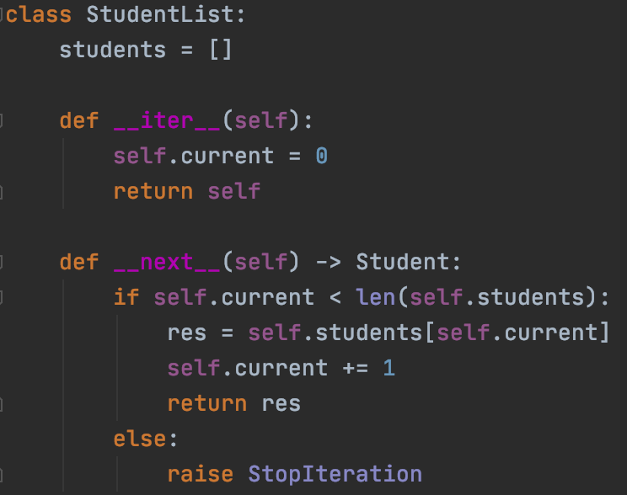
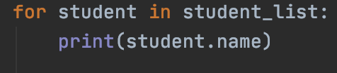
Iterator class
By adding an __iter__() and __next__() method to a class, it becomes iterable.

Slide 9
Generators
Creating Iterators is hard. It requires:
Definine a class
Implement an __iter__ and __next__ methods
Keep track of indices and raise exceptions.
Generators make the process easier and more compact, in case there isn’t a need for a class

Slide 10
Generator function
Using ‘yield’ the function creates an iterable.
Each call to next() on the iterable returns the next element.
Useful in loops and long sequences of data.
def fibonacci_with_generator(n): a = 1 b = 1 for i in range(n): yield a a,b = b, a+b a = fibonacci_with_generator(10) print(next(a)) print(next(a)) print('**** generator in for loop ***') for num in fibonacci_with_generator(10): print(num)

Slide 11
Generator function
Generator functions are a special kind of function that return a lazy iterator.
These are objects that you can loop over like a list.
However, unlike lists, lazy iterators do not store their contents in memory.
def infinite_sequence(): num = 1 while True:
yield num num *= 2 for i in infinite_sequence (): print(i, end = “ “)

Slide 12
Summary
We saw today how to:
Lambda functions
Iterators
Generators

